Slide 1
Movie Recommendation
By,
D.Ramprasad
T. Sravan Kumar

Slide 2
The Movie Data Base.
Movie data is available online readily or we can scrape it from online by using the API of the movie data base.
If we search one movie we can get to see the similar kind of movies in the recommendation.

Slide 3
Here in this project we have took the data from the movie data base which is tmdb movies.
The data is about the 5000 movies from past several years.
This data consists of the movie name, popularity, budget, tagline, and overview.

Slide 4
We have used the python programming language and the Jupyter notebook to execute the objective.
The process is to import the necessary libraries, data pre-processing and the doing co-sine similarity for the data set.
In the data pre-processing we have used TF-DIF to check the frequency of the important words.

Slide 5
TF-DIF- TF-IDF stands for term frequency-inverse document frequency and it is a measure, used in the fields of information retrieval (IR)
It weighs the words in terms of the importance.
TF = Number of time word appearing in the document is divided by the total number of words in the document.

Slide 6
IDF = log(Number of the documents in the corpus /(divided by) number of the documents in the corpus contain that word.
Example for TF : if we have word ram in the document for 20 times which contains 100 words the TF will be
TF=20/100 = 0.2
Example for IDF : if we have collection of the documents 10000 in that 100 documents have the word ram so the IDF is calculated as
IDF= log(10000/100) = 2
So the TF-IDF score for the word ram is calculated as
0.2*2 = 4

Slide 7
CO-SINE SIMILARITY
Cosine similarity is one of the metric to measure the text-similarity between two documents irrespective of their size in Natural language Processing.
A word is represented into a vector form.
Let’s suppose you have 3 documents based on a couple of star cricket players – Sachin Tendulkar and Dhoni.
Two of the documents (A) and (B) are from the Wikipedia pages on the respective players and the third document (C) is a smaller snippet from Dhoni’s wikipedia page.

Slide 8
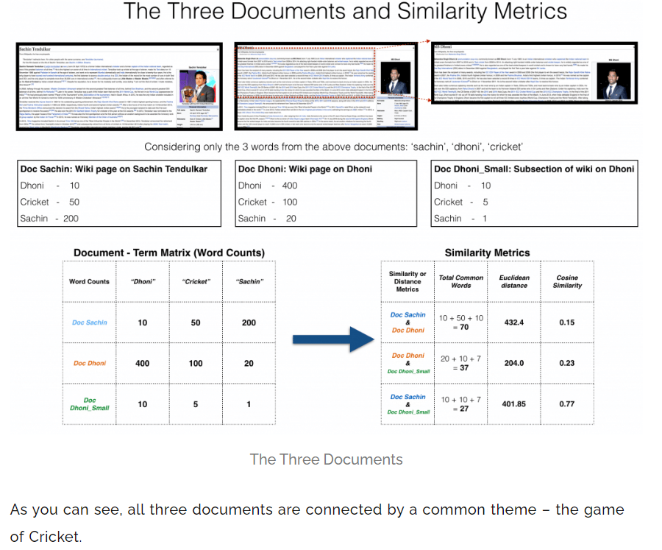

Slide 9
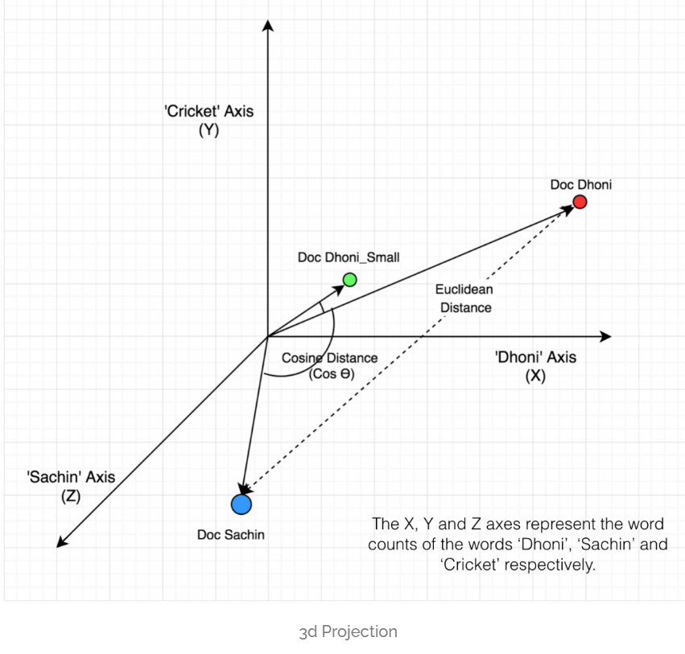
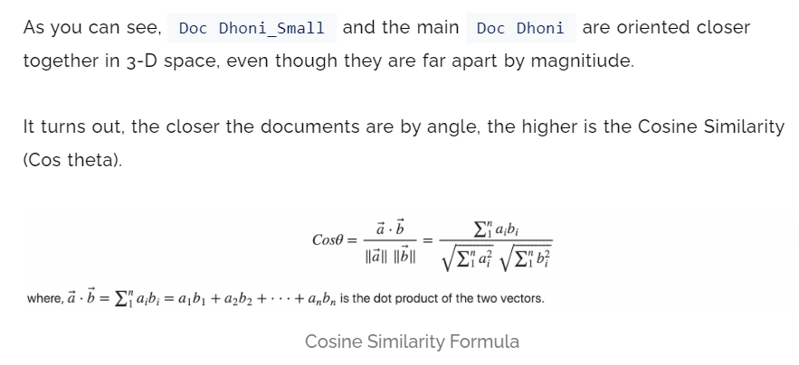

Slide 10
We will see the execution in the Jupyter notebook.
THANK YOU.

